Slide 1
Engineering Clinics
Team members:
Shivali Muthukumar - 18bcs068
Varshini r - 18bcs073
Kaviyarasi p - 18bcs086
Shalini r - 18bcs091
Kritya shree s - 18bcs093

Slide 2
World Happiness Report (2015-2020)
March 20 is celebrated as International World Happiness Day. United Nations has celebrated this day as a way to recognise the importance of happiness in the lives of people around the world.
World Happiness Report is a landmark survey of the state of global happiness that ranks countries by how happy their citizens perceive themselves to be.

Slide 3
Purpose
Analysing this data helps figure out what the citizens of a country feel and can implement changes in accordance to it. One can also try to predict the happiness score for the following year.
Factors that impact the happiness level *
Happiness factors on bases of continent *
Top and bottom 5 countries based on factors (2015-2020) *
Relation between happiness score and features *
Country Trends over the years *

Slide 4
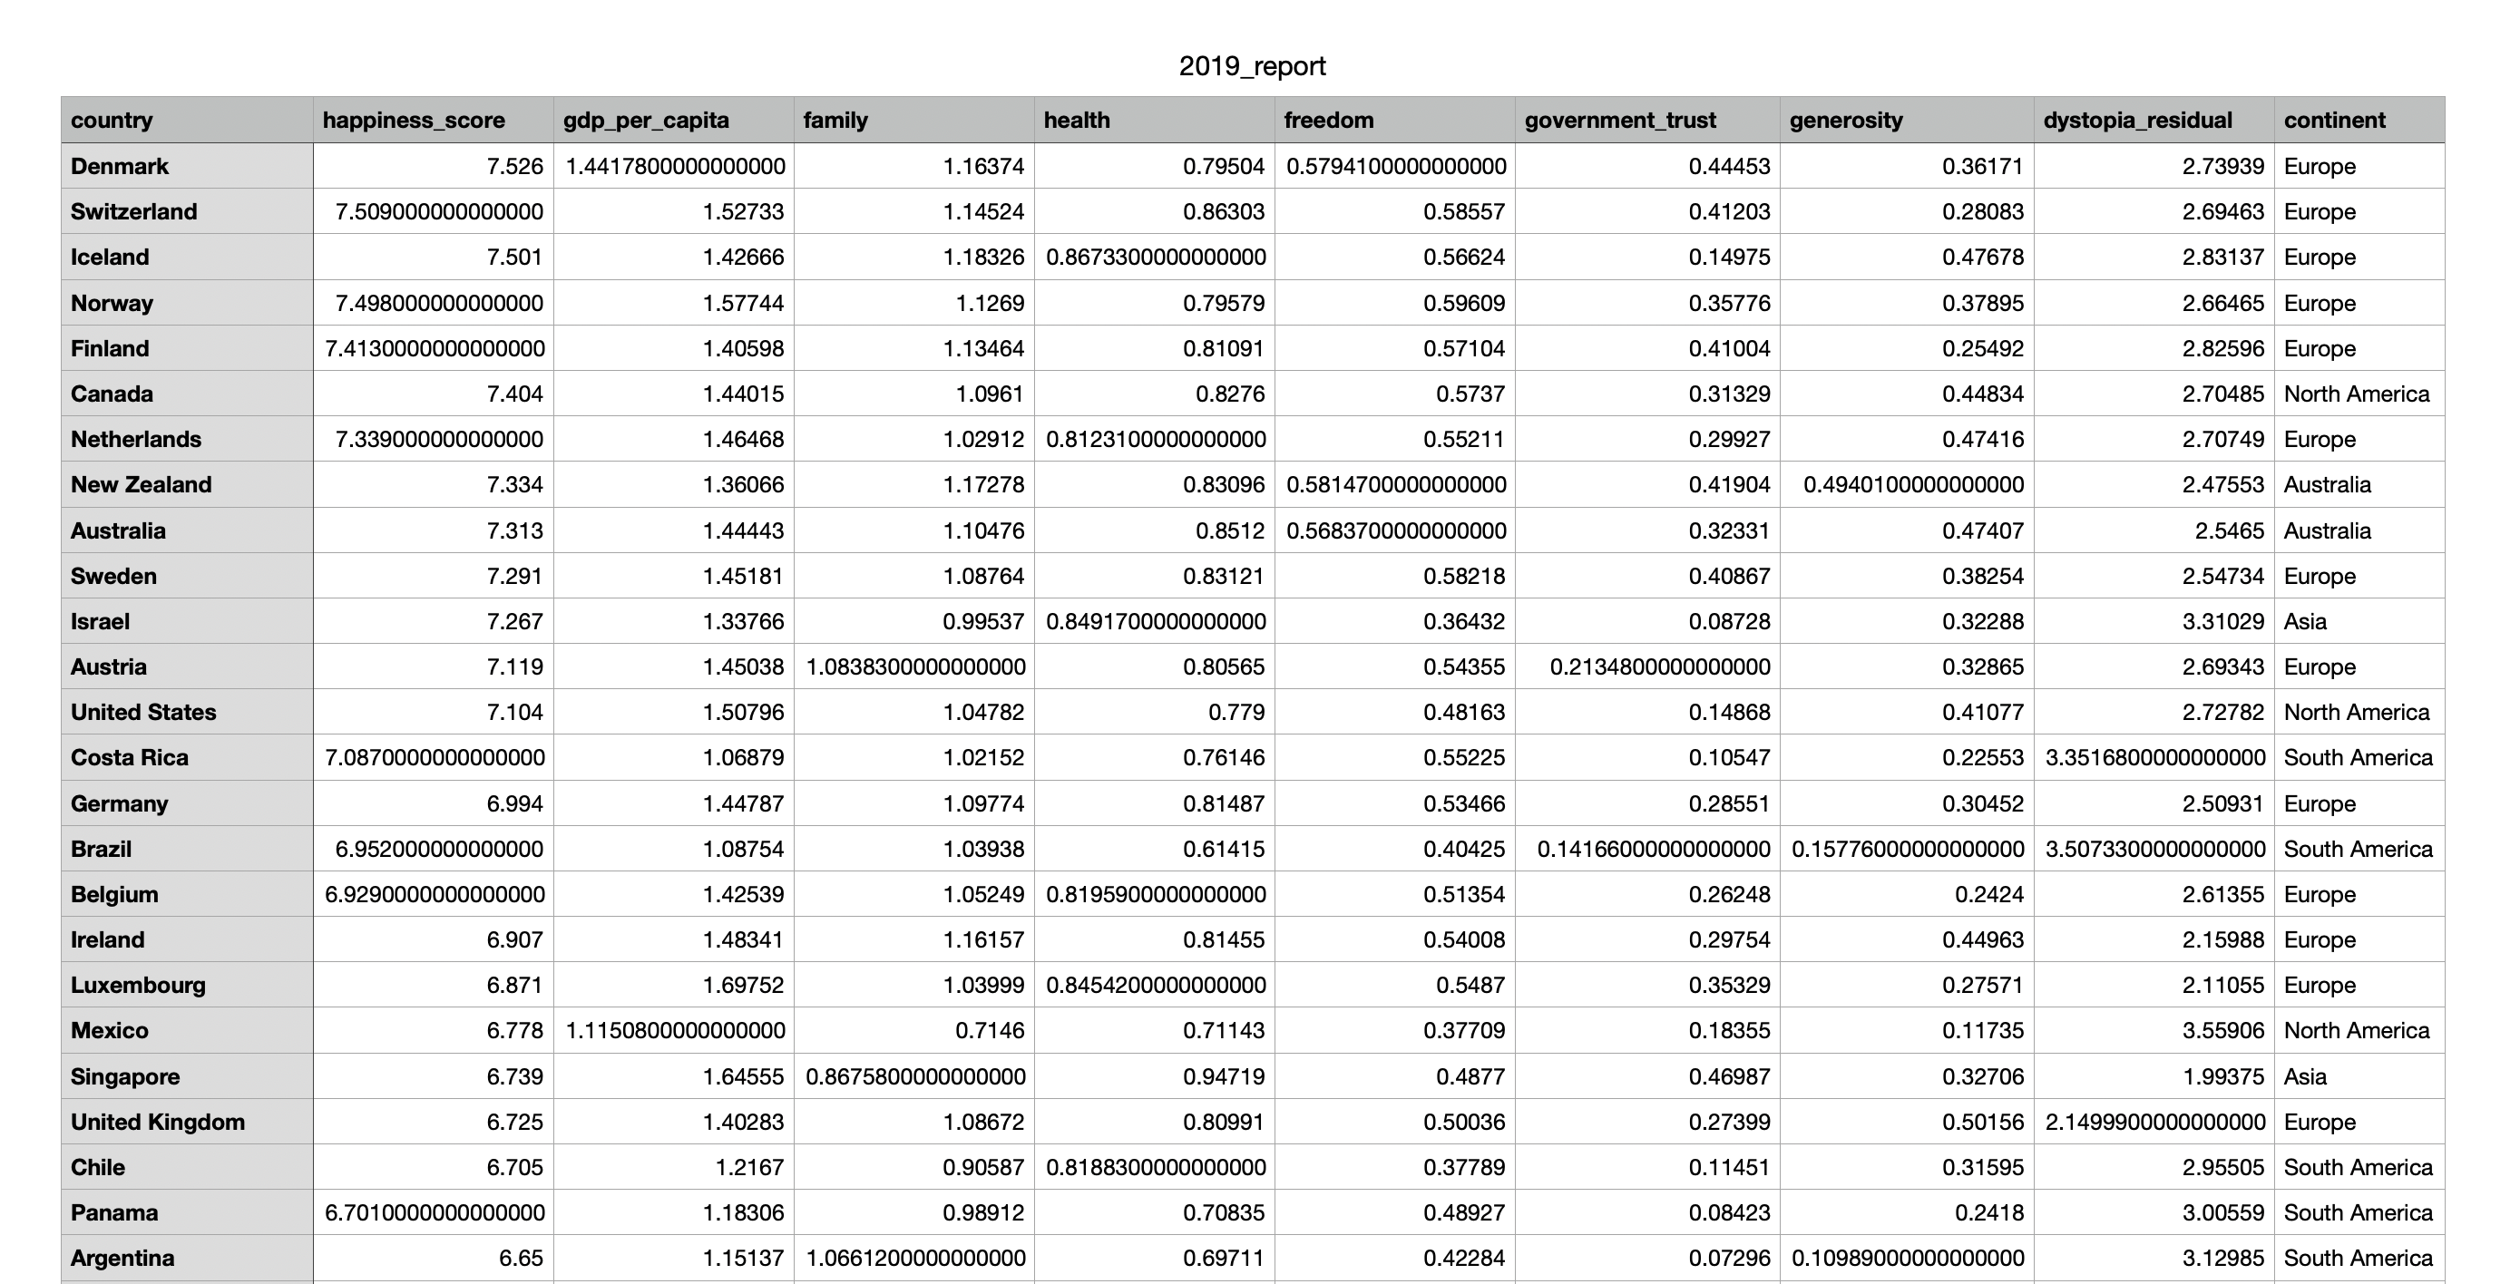
DataSET

Slide 5
Columns
Happiness Score: The sum of all the factors in the data (Out of 10)
Country
Continent: Which continent the country is present in
Economy: GDP of the country in the year is converted into a score (By taking natural log on GDP per Capita as this form fits perfectly with the data.)

Slide 6
Columns: Family, Health and freedom
Family: having someone to count on; Family or Social Support (Answers the question: Do you have any social support to help you when you are in trouble)
Health: how positively their inhabitants evaluate their expected future lives; (expected number of remaining years of life spent in good health from a particular age, typically birth or age sixty-five, assuming current rates of mortality and morbidity of a country.)
Freedom: Having a sense of freedom to make key life decisions Answers the question: “Are you satisfied or dissatisfied with your freedom to choose what you do with your life?”

Slide 7
Columns: Government trust, Generosity
Government Trust: Confidence of citizens in the actions of a “government to do what is right and perceived fair”; The score is based on the questions: “Is corruption widespread throughout the government or not?”, “And whether the citizens trust and are happy with the government”
Generosity: A willingness to give help or support; Generous spending leads to increased well-being. This score is based on: “Have you donated money to a charity in the past month?” on GDP per capita.

Slide 8
Columns: Dystopia Residual
Dystopia happiness score (1.85) i.e. the score of a hypothetical country that has a lower rank than the lowest ranking country on the report, plus the residual value of each country
It is a benchmark against which we may compare the evaluation of a country’s happiness. The lowest scores observed for the six key variables characterize Dystopia.

Slide 9
Reports and Papers Related to the data

Slide 10
World Happiness Report
The World Happiness Report is a landmark survey of the state of global happiness that ranks 156 countries by how happy their citizens perceive themselves to be. The ranking is based on subjective well-being and digs more deeply into how the social, urban and natural environments combine to affect our happiness.
The World Happiness Report is a publication of the Sustainable Development Solutions Network, powered by data from the Gallup World Poll.
https://worldhappiness.report/ed/2020/

Slide 11
WHR continued
It was to help national governments give more importance to happiness and well-being in determining how to achieve and measure social and economic development.
The distribution of answers to the Cantril ladder question asking respondents to value their lives today on a 0 to 10 scale, with the worst possible life as a 0 and the best possible life as a 10. This gave us a chance to compare happiness levels and inequality in different parts of the world.
The typical annual sample is 1,000 people. If a country had surveys in each year, then the sample size would be 3,000 people.

Slide 12
Happiness and Life Satisfaction
This research paper was first published in 2013 and had substantive revision May 2017.
The researchers discuss data and evidence which will answer to the questions:
How happy are people today?
Were people happier in the past?
How satisfied with their lives are people in different societies?
How do our living conditions affect all of this?

Slide 13
Happiness and Life Satisfaction Continued
Focus will be on survey-based measures of self-reported happiness and life satisfaction.
Surveys asking people about life satisfaction and happiness do measure subjective well-being with reasonable accuracy.
Life satisfaction and happiness vary widely both within and among countries. It only takes a glimpse at the data to see that people are distributed along a wide spectrum of happiness levels.
Most countries that have experienced sustained economic growth have seen increasing happiness levels. So the evidence suggests that income and life satisfaction tend to go together.
Important life events such as marriage or divorce do affect our happiness, but have surprisingly little long-term impact. The evidence suggests that people tend to adapt to changes.

Slide 14
Preprocessing

Slide 15
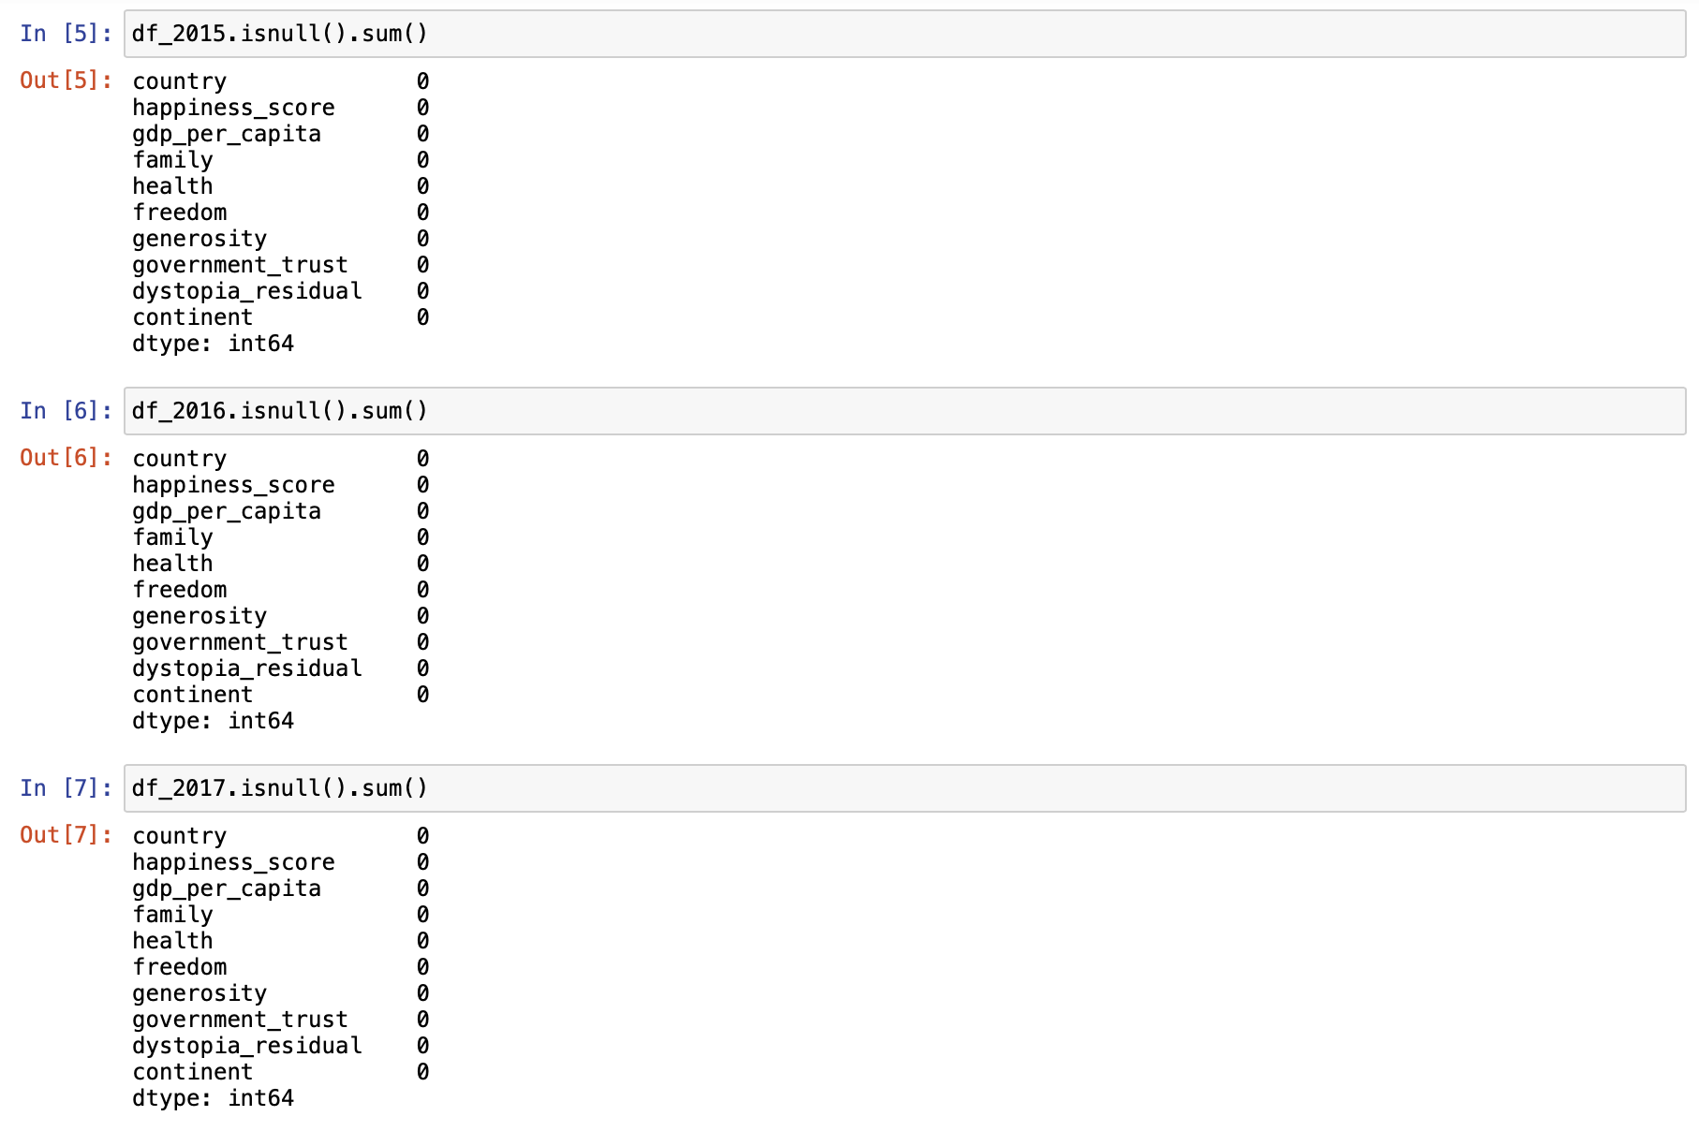
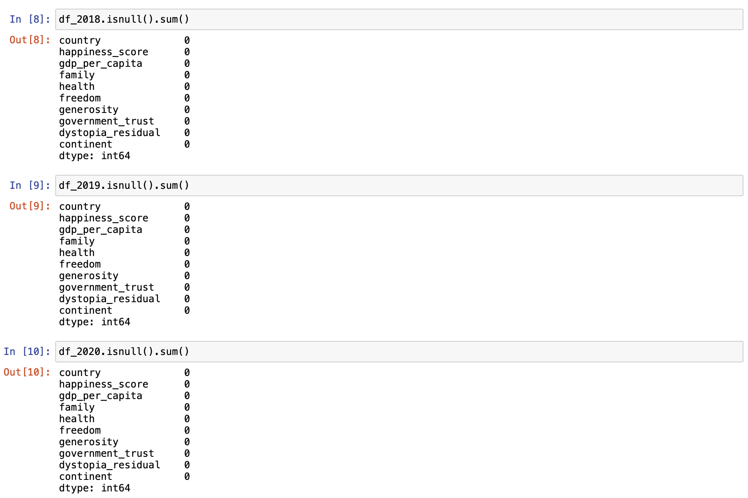
Checking for Null Values

Slide 16
Detecting outliers
Outliers are values that are notably different from other data points, and they can cause problems in statistical procedures.
A histogram was used to see if there were any outliers and a box plot was used to check how many outliers are there.

Slide 17
Removing outliers
Before Removing Outliers
After Removing Outliers

Slide 18
Normalization
Normalization is a technique often applied as part of data preparation for machine learning.
Its goal is to change the values of numeric columns in the dataset to a common scale, without distorting differences in the ranges of values.
For machine learning, every dataset does not require normalization.

Slide 19
Data Analysis

Slide 20
Factors that impact the happiness level

Slide 21
Factors that impact the happiness level
Inference:
In the year 2015 the main factor seem to be GDP, Family, Health and Freedom but,
After the year 2017, Govt Trust and generosity have played a role in a Country’s Happiness
In the year 2020, the correlations between generosity, govt trust and other factors have significantly decreased.
2015
2017
2020

Slide 22
Happiness factors on bases of continent

Slide 23
Happiness Score
A bar graph is used to denote this analysis. Bar graph is often used to compare between values of different categories in the data.
Inference
African countries have lowest happiness score, followed by Asia.
Australia and North America have the highest followed by Europe and South America.
The score of North America has been reduced over the years but scores of Asia and Europe have significantly increased.
2015
2020

Slide 24
Year 2015
Inference
Australia gives importance to all factors equally.
Africa has the lowest score in all factors.
Asia and South America give comparatively more importance to family/social support that the other factors.
Europe gives more importance to GDP, Health and Family.

Slide 25
Year 2020
Inference
There is a drastic decrease in GDP and generosity but an increase in health, freedom and govt trust in all continents.
Family value of Australia has decreased over the years.
Asia has a decrease in family/social support value
South America has an increase in health and freedom but the Europe gives more importance to GDP, Health and Family.

Slide 26
Top 10 Happiest countries based on factors (2015-2020)

Slide 27
All Factors
2015
2020

Slide 28
Inference
GDP: Singapore and Luxembourg have retained their position throughout the years and Ireland and Netherlands have increased in position.
Family: UK, Switzerland, Slovenia and Mongolia’s position have increased whereas Spain being 1st in 2015 is now not on the list.
Health: Singapore and Japan have retained their positions. Switzerland, Spain and Australia have an increase but South Korea and Italy have a drastic decrease in position.
Generosity: Positions of Iceland and Australia have increased but the rest of the positions are different in 2020.
Govt Trust: UK, Netherlands and Ireland have an increase in position.
Freedom: Uzbekistan has retained its position as 1 and the top 5 countries are almost the same both years.

Slide 29
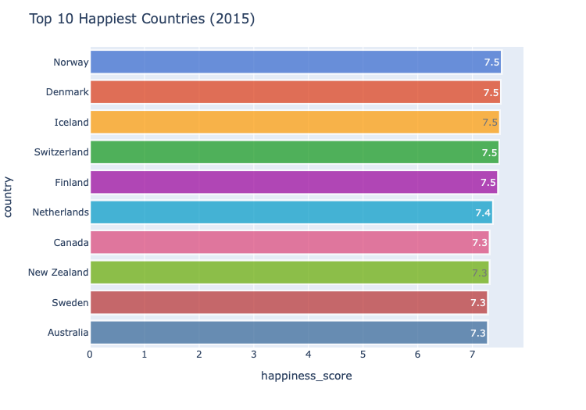
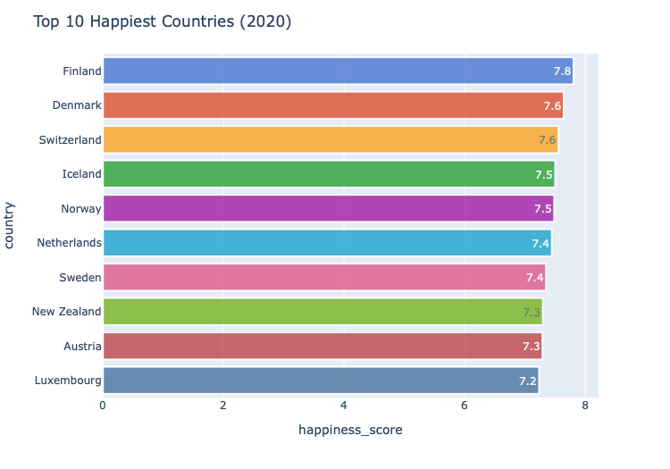
Happiness Score
Inference
The first 6 countries are the same both years with a few of their positions shuffled.
New Zealand has also retained its 7th position in the top 10 and Sweden has increased in 2 positions.
Canada and Australia have lost their top 10 positions in 2020.

Slide 30
Top 10 UnHappiest countries based on factors (2015-2020)

Slide 31
All Factors
2015
2020

Slide 32
Inference
GDP: The first 5 positions are the same countries with their positions swapped and Madagascar. The rest in 2015 have improved by 2020.
Family: The first positions is retained by Congo. Ivory Coast and Madagascar have risen from being in 6th and 7th to 2nd and 3rd positions.
Health: Except South Africa, the same countries as in 2015 is retained in 2020 with changes in positions.
Generosity: Argentina has risen from position 7 to 2 in 2020. The rest of the countries are very different in both years.
Govt Trust: Thailand and Kyrgyzstan have increased in positions in 2020 whereas Mongolia and Russia have come from 2nd and 3rd position to 9th and 10th position.
Freedom: Afganistan has 0 freedom in the year 2020 and only very few different countries in the 2020 list.

Slide 33
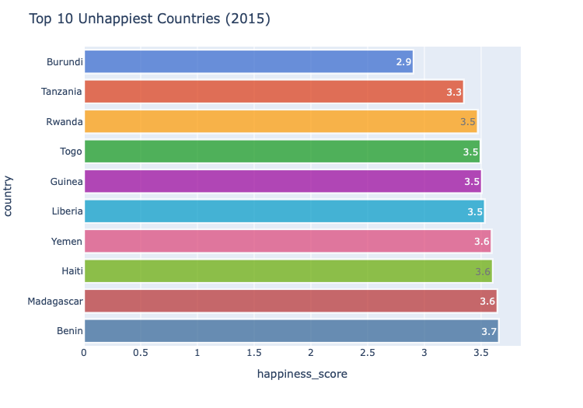
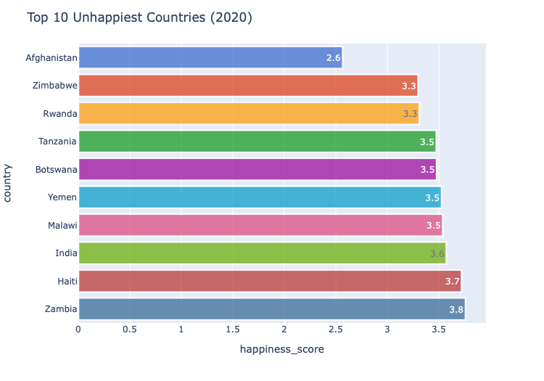
Happiness Score
Inference
Burundi has improved over the years and is not in the top 10 unhappiest counties in 2020.
Tanzania has jumped from 2nd to 4th position in 2020.
Yemen and Rwanda have maintained their positions.
India has joined the list in the year 2020.

Slide 34
Relation between happiness score and features

Slide 35
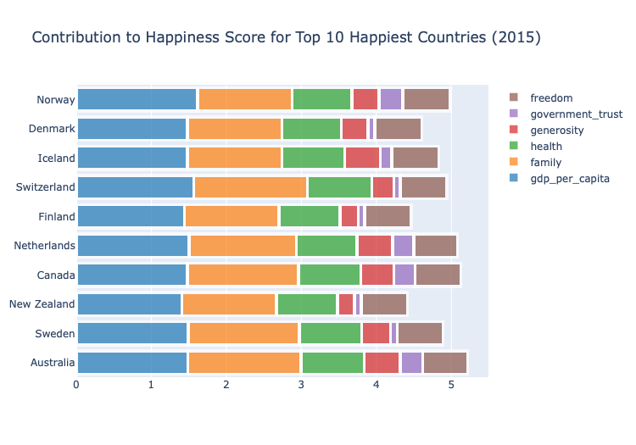
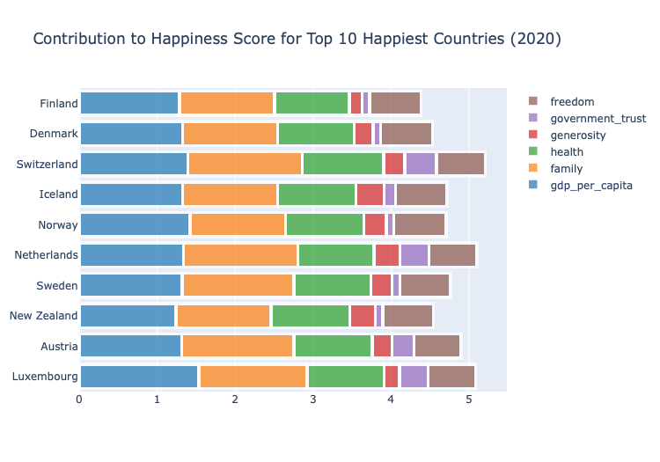
Top 10 happiest countries
This can be used to predict what a country must focus on to improve their happiness score furthermore.
Inference
As mentioned in the correlation heatmap; GDP, family, health and freedom are the main factors contributing in the top 10 countries.
Generosity and Govt Trust can be improved in all countries in both years.
Health has gained more importance in the year 2020 compared to 2015 but family has decreased in 2020.

Slide 36
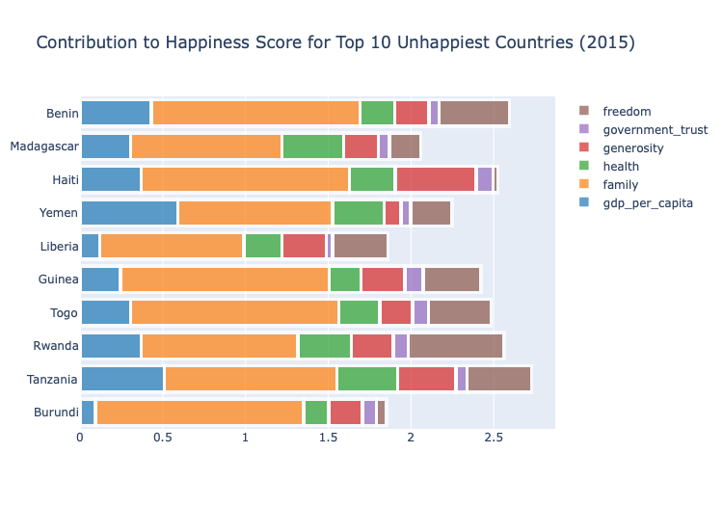
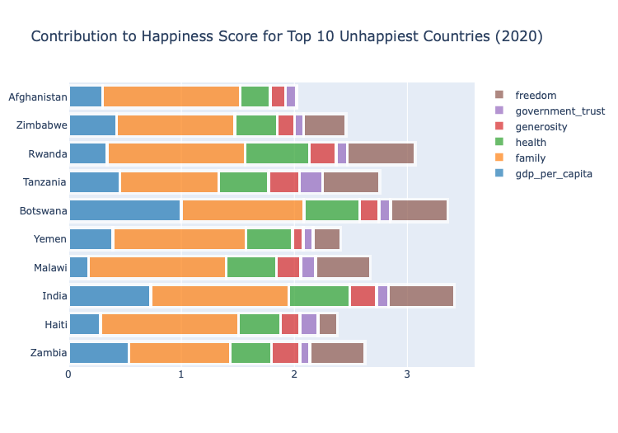
Top 10 Unhappiest countries
This can be used to predict what a country must focus on to improve their happiness score furthermore.
Inference
More importance is given to family and freedom compared to the happiest countries.
As mentioned health has improved in 2020.
The overall scale has improved from 3 being max in 2015 to 3.5 in 2020.

Slide 37
Happiness score Trends over the years

Slide 38
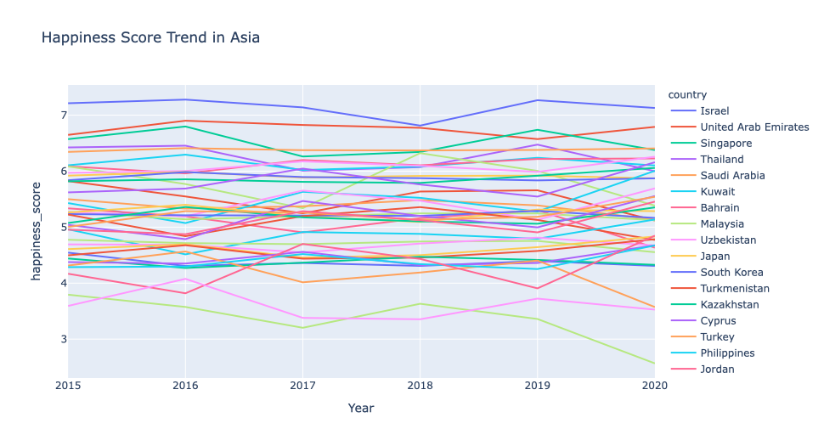
Score trend over the years
With this information we can see how the countries happiness score is throughout the years and also see if it’s likely to go up or down the following year.

Slide 39
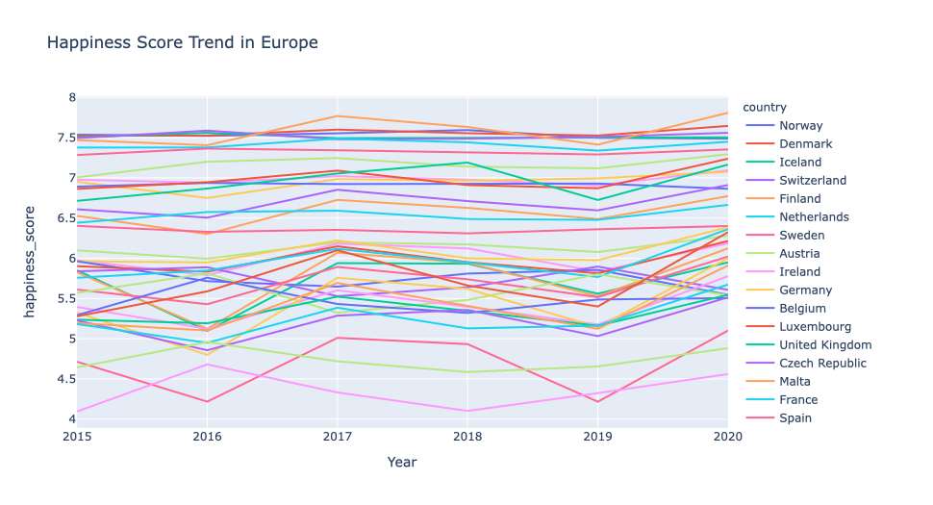
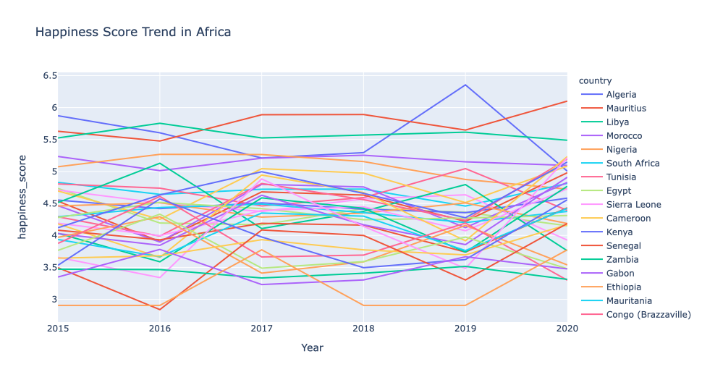
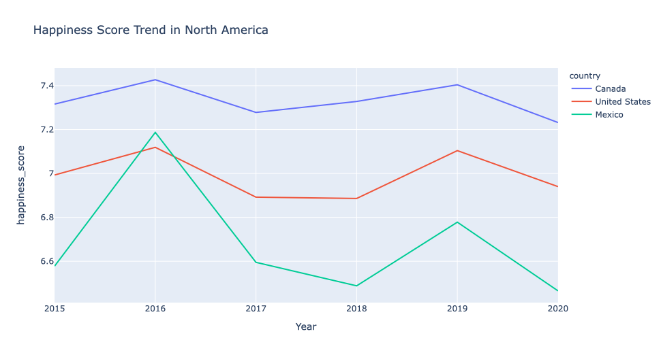
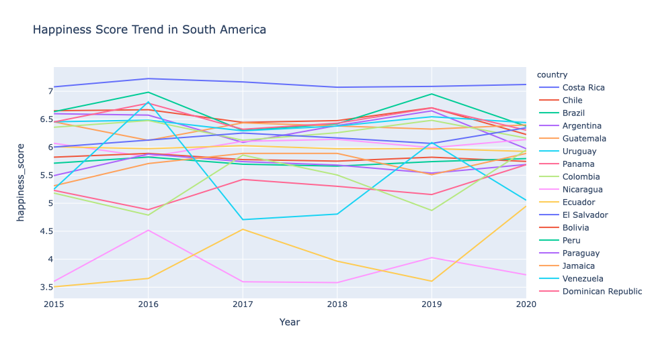
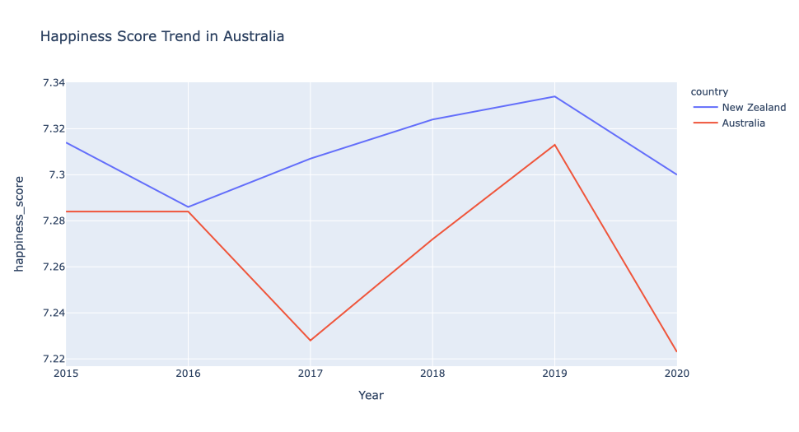

Slide 40
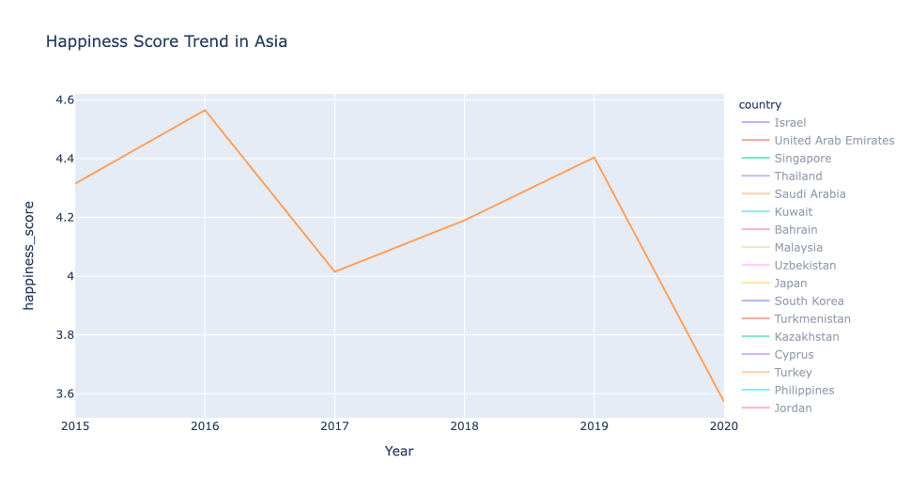
Score trend India
The happiness scores throughout the last 6 years were non-linear.
It was in its peak in the year 2016 with 4.56 and next peak in 2019 with 4.40.
The lowest score is in the year 2020 with 3.57 as the score and has also secured 8th position in “Top 10 unhappiest countries in 2020”.

Slide 41
Thank You

